Slide 1
MediCall Project Update
Haeryn Kim, Lizbeth Leapo, Deepthi Nacharaju

Slide 2
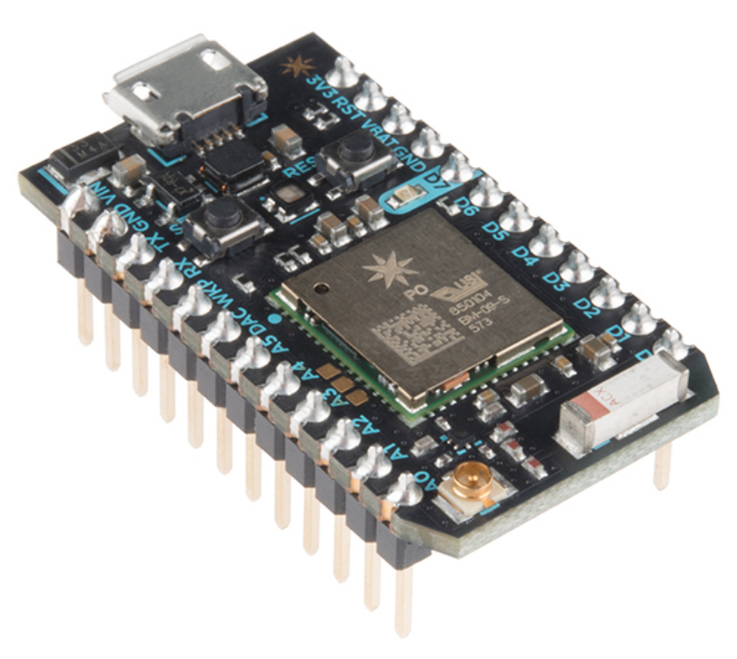
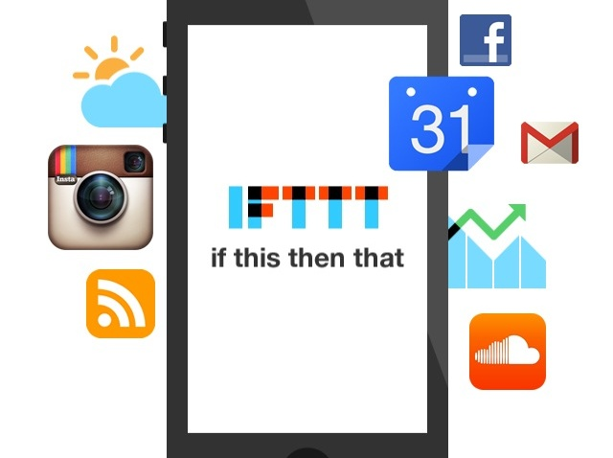
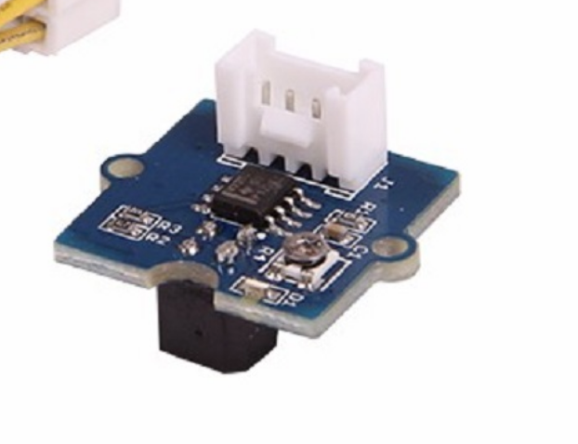
Our prototype:
Grove Reflective Infrared Sensor
Reflectivity of IR light varies with distance of reflecting surface.
Particle Photon
WiFi module connected to Duke Visitor
IFTTT
App that sends us “MediCall device activated” when IR sensor is touched for 5 seconds.

Slide 3
Demo video
Features:
5 second minimum activation
Push notification to phone

Slide 4


Slide 5
Future directions
Add feedback lights to protype
Reducing time it takes to receive signal
CAD rendering of call bell/hospital bed attachments
Transition to Bluetooth serial module because WiFi might be inaccessible in hospital
Research hospital communications (e.g. call bell) regulations

